Slide 1
Optimal Acceleration and Braking Sequences for Vehicles in the Presence of Moving Obstacles
Jeff Johnson, Kris Hauser
School of Informatics and Computing

Slide 2
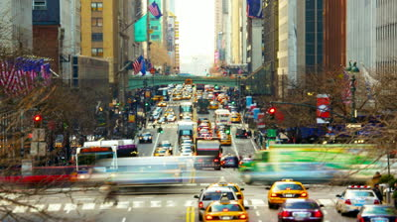
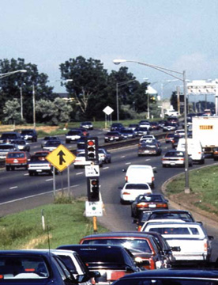
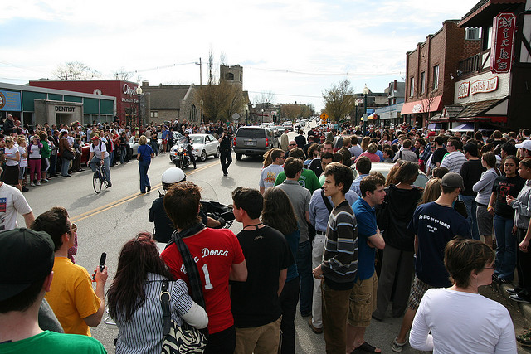
Motivation

Slide 3
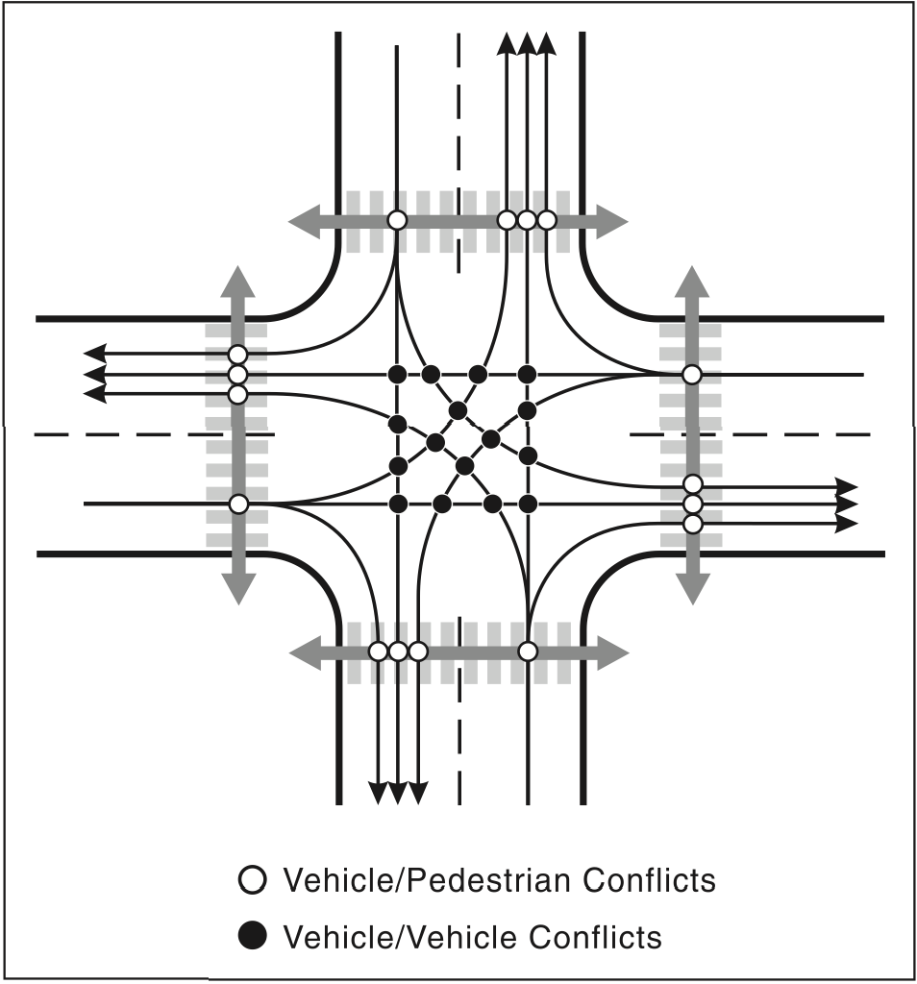
Motivation
Frequency of automobile collisions is directly related to the number of conflict points
-U.S. Federal Highway Administration
Vehicle/Vehicle and Vehicle/Pedestrian conflict points at an urban intersection
(figure: U.S. Federal Highway Administration)

Slide 4
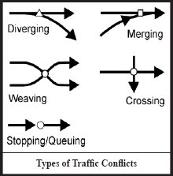
Motivation
In many systems, conflict types have specialized planners
Our approach: define a general planner for conflict resolution
http://ops.fhwa.dot.gov/publications/amprimer/access_mgmt_primer.htm

Slide 5
Related Work
Randomized planning with dynamic constraints:
R. Kindel, D. Hsu, J.-C.Latombe, and S. Rock (2000): Used probabilistic roadmap variant with fast replanning
MIT Team for DARPA Urban Challenge (2007): Used real-time implementation of Rapidly-exploring Random Trees
CMU Team for DARPA Urban Challenge (2007): Extract path based on lane centerline, sample candidate trajectories that follow the path
Randomized methods offer no optimality guarantees, only probabilistically complete
Deterministic planning with dynamic constraints:
Kant and Zucker (1986): Introduced a Path-Time decomposition and a visibility graph for trajectory construction
Did not consider acceleration bounds
T. Fraichard (1993): Used A* to search a discretized state space
Not practical for large problems

Slide 6
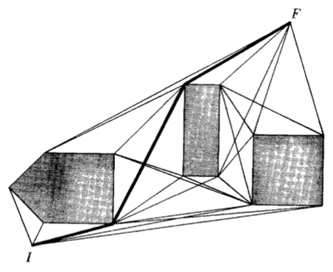
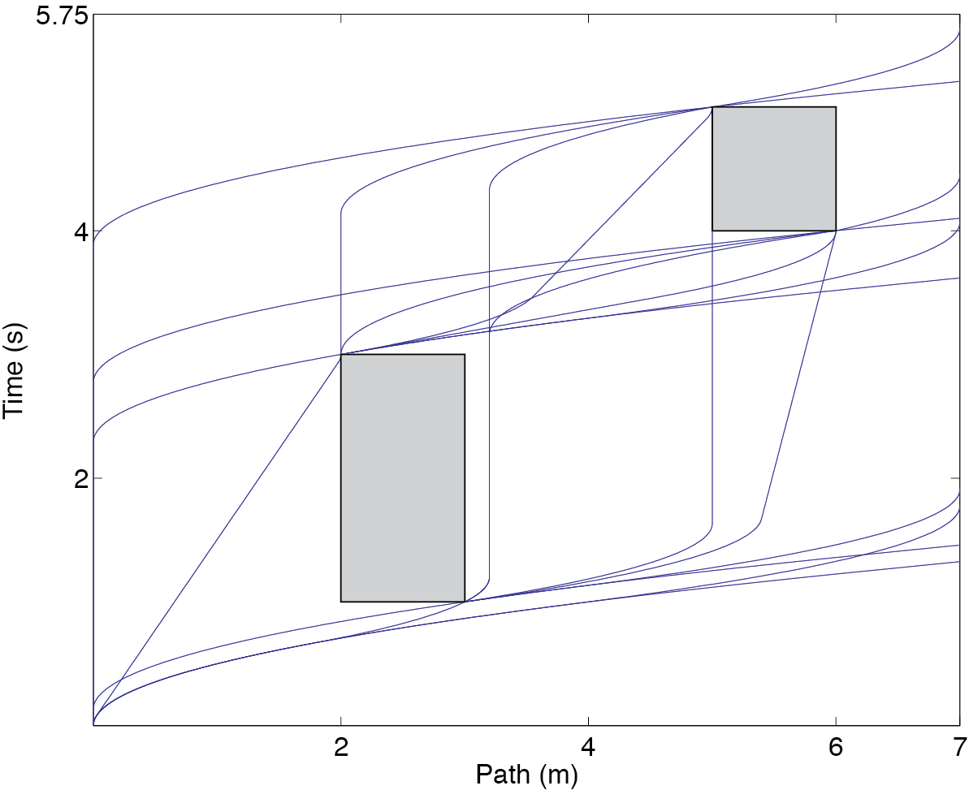
Our Previous Work
We extend the visibility graph approach to respect acceleration constraints (Johnson, Hauser, ICRA 2012)
Kant, Zucker, 1986
Visibility with unbounded accelerations
Visibility with bounded accelerations

Slide 7
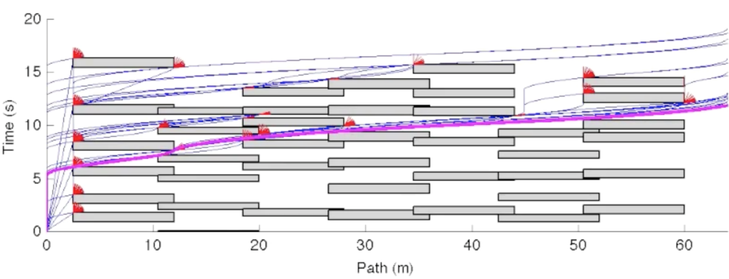
Our Previous Work
However:
Obstacle paths are linear and perpendicular
Obstacles travel with constant acceleration
Planner relies on axis-aligned rectangular PT obstacles

Slide 8
Current Contribution
Improved construction of Path-Time (PT) obstacle
Piecewise linear paths for world obstacles
Arbitrary polygonal models for world obstacles
Complex and uncertain obstacle velocity profiles
Planner extension for polygonal PT obstacles
Planner performs edge and vertex propagation
Planning remains polynomial time
We demonstrate through simulation that our method handles heterogeneous conflict types while remaining fast enough for online planning

Slide 9
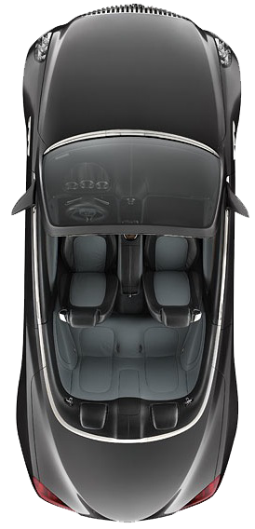
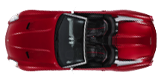
Problem Definition
Plan a time-optimal velocity profile along a given path in the presence of moving obstacles.
Obstacle
Obstacle
Agent
Path 1
Path 2
Subject to:
Bounded, positive velocity
Bounded acceleration
Must be collision free
Assume:
Obstacle behavior is bounded
Agent/Obstacle behaviors are independent

Slide 10
Path-Time Obstacles: Construction
Definition:
Union over all t of all configurations at which collision occurs
t = 1
t = 2
t = 3
World space
Assume:
Known, piecewise linear paths
Bounded behavior
Path-time space
t = 3
Time
t = 2
Algorithm:
Discretize time dimension
Compute min/max possible collision positions at each t
Take conservative bound of intervals
t = 1
Forbidden interval
Path Position

Slide 11
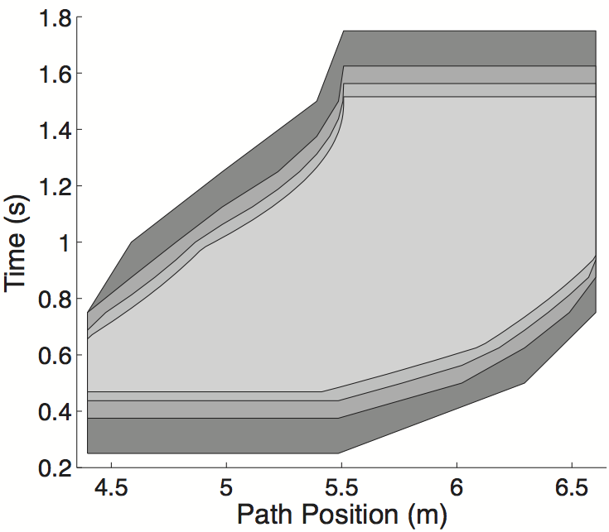
Path-Time Obstacles: Construction
Iterative computation:
Iteratively compute forbidden region
Resolution complete:
More grid points yields tighter approximation

Slide 12
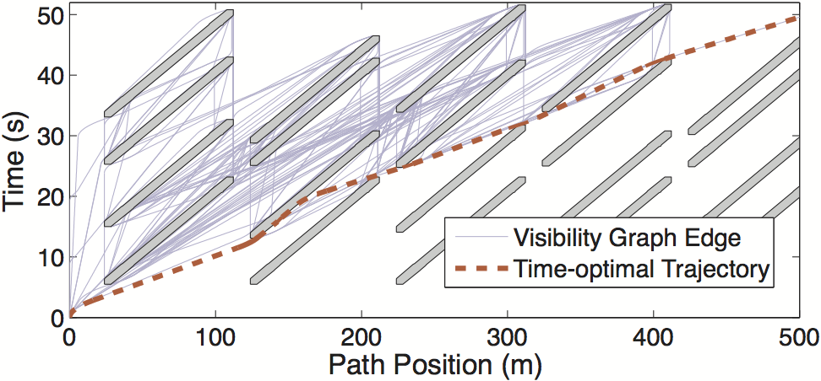
Planning in Path-Time Space
Task: Compute a minimum-time curve from start to goal
Input: PT obstacles, Dynamic constraints
Output: Visibility graph, recovered trajectory

Slide 13
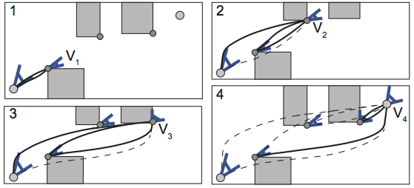
Planning in Path-Time Space
Intuition: Any non-trivial optimal curve is tangential to a PT obstacle
Approach: Iteratively compute reachable velocities at tangencies
Reachable velocity propagation along vertices

Slide 14
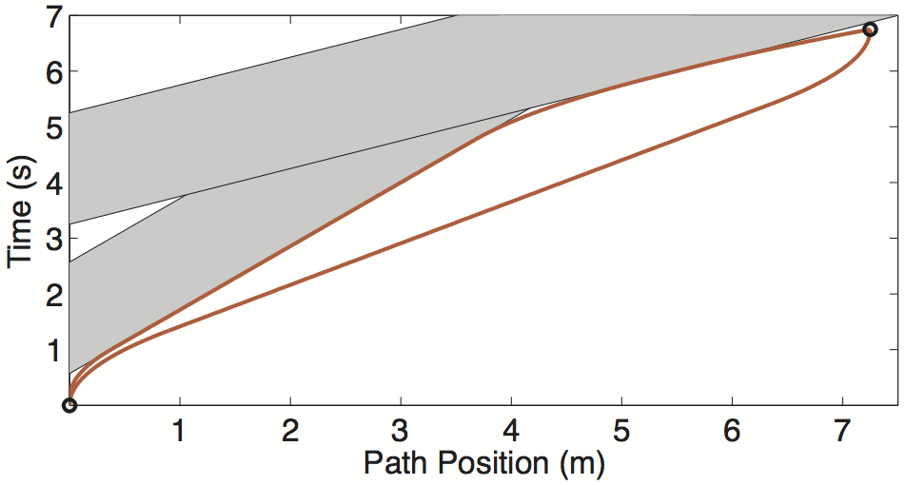
Planning in Path-Time Space
Edge tangencies: Intersected edges are recursively traced while propagating between vertices
Reachable velocity propagation along edges

Slide 15
Propagation with Polygonal Obstacles

Slide 16
Demonstration

Slide 17
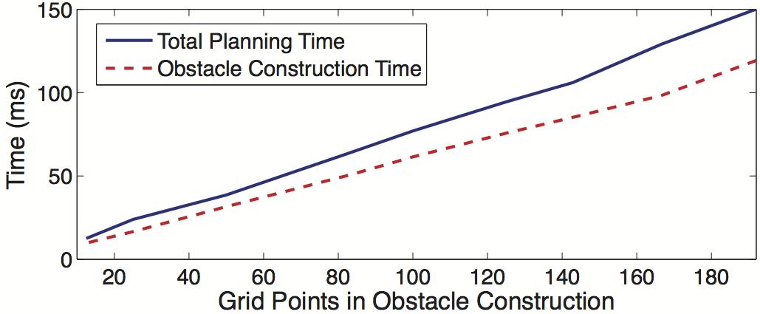
Empirical Performance
Resolution Scalability:
Scales well with obstacle resolution
Practical resolutions (100 to 140) yield replanning rates of ~10Hz
Obstacle construction: O(L_{A}m²k+L_{o}log m)
Planning: O(cdN³)

Slide 18
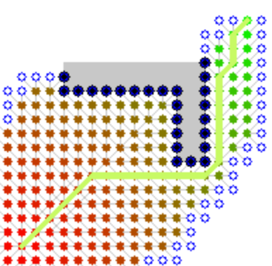
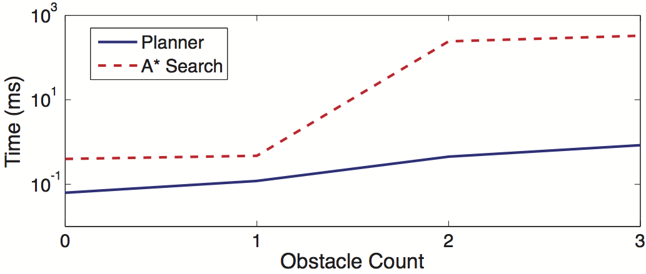
Empirical Performance
Comparison to A* search:
Discretizes state space and performs A* search (T. Fraichard, C. Laugier, 1993)
Our method is significantly faster when many obstacles obstruct trajectory
Example A* search:
Directed search of discretized space (image: Wikipedia)
(note the logarithmic time scale)

Slide 19
Application: Autonomous Vehicles
Objective:
Drive the car (right) to the second stop sign
Avoid obstacles, respect stop signs, minimize travel time
Obstacles:
2 bicycles (blue paths)
6 pedestrians (green paths)

Slide 20
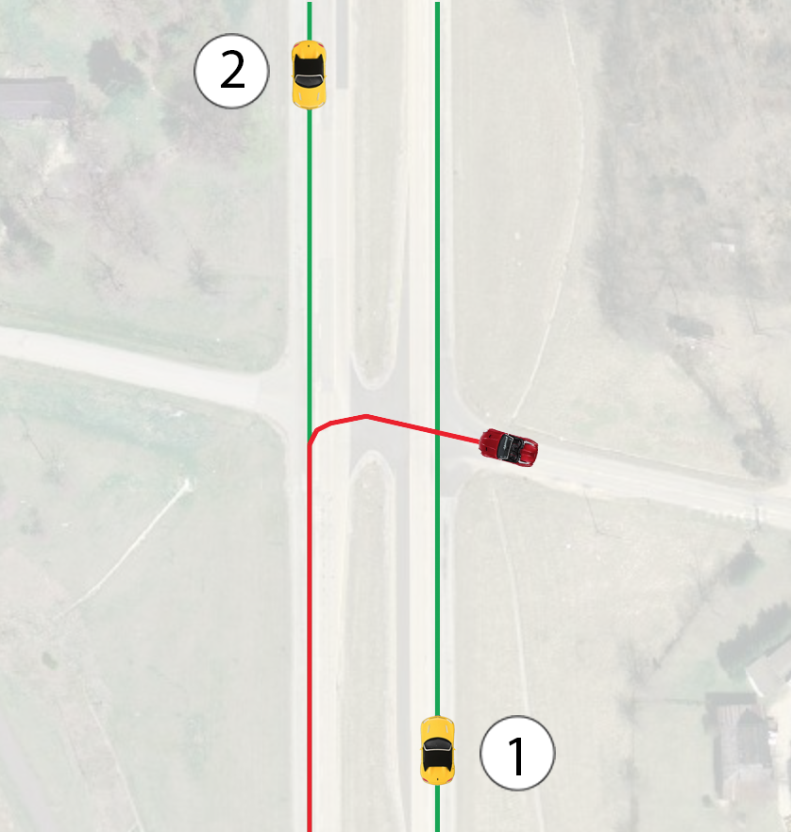
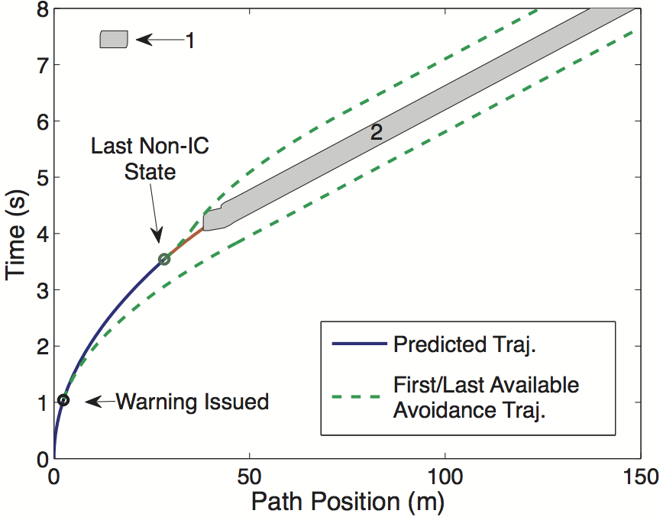
Application: Collision Warning
Assume predictable driver behavior to time horizon τ
Collision check until τ
Check feasibility at end of τ

Slide 21
Application: Collision Warning

Slide 22
Conclusion
Fast, exact, complete planning system
Unified framework for conflict point resolution
Code is available:
http://www.indiana.edu/~motion/iv2013/
Future: Working with Bosch to prototype system on an intelligent vehicle

Slide 23
Questions?

